Slide 1
Engineering Economics
DR. SUMANT WACHASUNDAR

Slide 2
Syllabus
Introduction to Engineering Economics: The Art and Science of Economic Analysis; Tools of Economic Analysis; Engineering Efficiency; Meaning and Scope of Engineering economics; Elementary Engineering Analysis
Behavior of Profit Maximizing Firms: Production Function: Law of variable Proportion; Law of returns to scale; Profit Maximization of commutative firm -Cost and revenue concepts; Types of Markets-Monopoly, Oligopoly, and Monopolistic Competition
Time Value of Money: Interest - Simple and compound; nominal and effective rate of interest; Cash flow diagrams; Principles of economic equivalence; Internal rate of return; Cost benefit analysis for public projects
Depreciation: Depreciation of capital asset, causes of depreciation, Methods of calculating depreciation (Straight line method, Declining balance method), After tax comparison of project. Evaluation of public alternatives- introduction; Inflation adjusted decisions and procedure to adjust inflation; comparison of alternatives and determination of economic life of asset
Banking and Development: The functions of commercial and central bank : Foreign Direct Investment : Free trade vs. Protectionism; Capital formation; Recession and stagnation; Inclusive growth; Public-Private partnership for development; Basics of National Income Accounting

Slide 3
UNIT I
Economics is the science that deals with the production and consumption of goods and services and the distribution and rendering of these for human welfare. The following are the economic goals.
A high level of employment
Price stability
Efficiency
An equitable distribution of income
Growth
Some of the above goals are interdependent. The economic goals are not always complementary; in many cases they are in conflict. For example, any move to have a significant reduction in unemployment will lead to an increase in inflation.

Slide 4
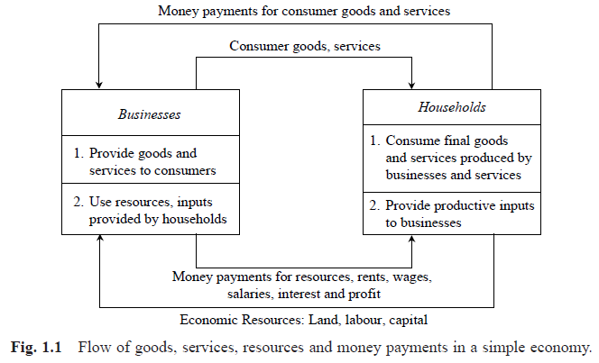
Flow in an Economy

Slide 5
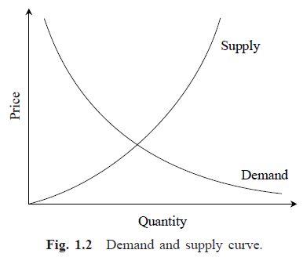
Law of Supply and Demand
Factors influencing demand
The shape of the demand curve is influenced by the following factors:
Income of the people
Prices of related goods
Tastes of consumers
Factors influencing supply
The shape of the supply curve is affected by the following factors:
Cost of the inputs
Technology
Weather
Prices of related goods

Slide 6


CONCEPT OF ENGINEERING ECONOMICS
Science is a field of study where the basic principles of different physical systems are formulated and tested.
Engineering is the application of science.
It establishes varied application systems based on different scientific principles.
Types of Efficiency
Technical efficiency
Economic efficiency

Slide 7
Definition of Engineering Economics
Efficient functioning of any business organization would enable it to provide goods/services at a lower price.
In the process of managing organizations, the managers at different levels should take appropriate economic decisions which will help in minimizing investment, operating and maintenance expenditures besides increasing the revenue, savings and other related gains of the organization.
Definition
Engineering economics deals with the methods that enable one to take economic decisions towards minimizing costs and/or maximizing benefits to business organizations.

Slide 8
ELEMENTARY ECONOMIC ANALYSIS
Whether it is a business situation or a day-to-day event in somebody’s personal life, there are a large number of economic decision making involved.
The following factors will affect the decision:
Price of the raw material
Transportation cost of the raw material
Availability of the raw material
Quality of the raw material
Consider the alternative of sourcing raw materials from a nearby place with the following characteristics:
The raw material is more costly in the nearby area.
The availability of the raw material is not sufficient enough to support the operation of the industry throughout the year.
The raw material requires pre-processing before it is used in the production process. This would certainly add cost to the product.
The cost of transportation is minimal under this alternative.

Slide 9
EXAMPLES FOR SIMPLE ECONOMIC ANALYSIS
In this section, the concept of simple economic analysis is illustrated using suitable examples in the following areas:
Material selection for a product
Design selection for a product
Design selection for a process industry
Building material selection for construction activities
Process planning/Process modification

